Slide 1
Subtopic 9 (Crossover) – Limits of accuracy
LEARNING OUTCOME: To find the error interval or limits of accuracy of numbers that have been rounded to different degrees of accuracy.
Objectives:
Keywords:
-Error interval
-Limits of accuracy
-Lower bound
-Upper bound
1. To find the error interval.
2. To find the limits of accuracy.
3. To answer worded questions on rounding.
Definition
Characteristics
Upper Bound: The maximum value a number or measurement can be.
Lower Bound: The minimum value a number or measurement can be.
Values that define the upper and lower limits of a number or function, especially in rounding or error intervals.
Bounds
Examples
Non - Examples
When 15 is rounded to the nearest integer, the lower bound is 14.5 and the upper bound is 15.5
When 15 is rounded to the nearest integer, the lower bound is 14 and the upper bound is 15.4
Upper and lower bounds.
Example 1 - I do…
Example 2 - We do…
Example 3 – You do…
Steps | Work out the upper bound and lower bound for…
1. Identify the degree of accuracy stated. | 32 cm, measured to the nearest cm. The lower bound = The upper bound = | 48 cm, measured to the nearest cm The lower bound = The upper bound = | 75 cm, measured to the nearest cm The lower bound = The upper bound =
2. For the lower bound, work out the lowest it could be.
3. For the upper bound, work out the greatest it can be.

Slide 2
Example 4 - I do…
Example 5 - We do…
Example 6 – You do…
Steps | Work out the upper bound and lower bound for…
1. Identify the degree of accuracy stated. | 3000, rounded to the nearest thousand. The lower bound = The upper bound = | 2000, rounded to the nearest hundred. The lower bound = The upper bound = | 8000, rounded to the nearest thousand. The lower bound = The upper bound =
2. For the lower bound, work out the lowest it could be.
3. For the upper bound, work out the greatest it can be.
Independent Practice
Question 1
Value | Rounded to | Lower Bound | Upper Bound
6000 | Nearest thousand
6000 | Nearest hundred
600 | Nearest hundred
600 | Nearest ten
6000 | Nearest ten
60 | Nearest ten
60 | Nearest whole
6 | Nearest whole
6000 | Nearest whole
600 | Nearest whole

Slide 3
Example 7 - I do…
Example 8 - We do…
Example 9 – You do…
Steps | Work out the upper bound and lower bound for…
1. Identify the degree of accuracy stated. | A plank of wood is 22.8cm to one decimal place. Find the lower bound and the upper bound. The lower bound = The upper bound = | A plank of wood is 2.3m to one decimal place. Find the lower bound and the upper bound. The lower bound = The upper bound = | A plank of wood weighs 765.4g to one decimal place. Find the lower bound and the upper bound. The lower bound = The upper bound =
2. For the lower bound, work out the lowest it could be.
3. For the upper bound, work out the greatest it can be.
Example 10 - I do…
Example 11 - We do…
Example 12 – You do…
Steps | Work out the upper bound and lower bound for…
1. Identify the degree of accuracy stated. | Work out the upper bound and lower bound for 37.82 cm, measured to two decimal places. The lower bound = The upper bound = | Work out the upper bound and lower bound for 5.78kg measured to two decimal places. The lower bound = The upper bound = | Work out the upper bound and lower bound for 157.25mm measured to two decimal places. The lower bound = The upper bound =
2. For the lower bound, work out the lowest it could be.
3. For the upper bound, work out the greatest it can be.
Independent Practice
Question 2
Value | Rounded to | Lower Bound | Upper Bound
2.5 | 1 decimal place
15.9 | 1 decimal place
20.4 | 1 decimal place

Slide 4
Question 2 continued
Value | Rounded to | Lower Bound | Upper Bound
20.4 | 1 decimal place
28.3 | 1 decimal place
120.2 | 1 decimal place
2.57 | 2 decimal places
8.82 | 2 decimal places
34.91 | 2 decimal places
0.43 | 2 decimal places
9.20 | 2 decimal places
4.258 | 3 decimal places
6.532 | 3 decimal places
18.742 | 3 decimal places
0.981 | 3 decimal places
4.200 | 3 decimal places

Slide 5
Example 13 - I do…
Example 14 - We do…
Example 15 – You do…
Steps | Work out the upper bound and lower bound for…
1. Identify the degree of accuracy stated. | A table is measured at 300cm long rounded to one significant figure. Find the lower bound and upper bound. The lower bound = The upper bound = | A chair is measured at 46cm long rounded to two significant figures. Find the lower bound and upper bound. The lower bound = The upper bound = | A cupboard is measured at 4300m tall rounded to two significant figures. Find the lower bound and upper bound. The lower bound = The upper bound =
2. For the lower bound, work out the lowest it could be.
3. For the upper bound, work out the greatest it can be.
Independent Practice
Question 3
Value | Rounded to | Lower Bound | Upper Bound
4000 | 1 significant figure
5000 | 1 significant figure
6000 | 1 significant figure
600 | 1 significant figure
60 | 1 significant figure
6 | 1 significant figure
5300 | 2 significant figures
5200 | 2 significant figures
5100 | 2 significant figures
5000 | 2 significant figures

Slide 6
Question 3 continued
Value | Rounded to | Lower Bound | Upper Bound
5320 | 3 significant figures
5310 | 3 significant figures
5300 | 3 significant figures
8000 | 3 significant figures
8000 | 2 significant figures
8000 | 1 significant figure
8 | 1 significant figure
0.8 | 1 significant figure
3.8 | 2 significant figures
3.7 | 2 significant figures
13.7 | 3 significant figures
1.37 | 3 significant figures
1.38 | 3 significant figures
Question 4 - Work out the following:
a) Upper and lower bounds of 286 metres to the nearest metre.
Upper bound =
Lower bound =
b) Upper and lower bounds of 21cm to the nearest cm.
Upper bound =
Lower bound =
c) Upper and lower bounds of 7.8cm to 1 decimal place.
Upper bound =
Lower bound =
d) Upper and lower bounds of 5.24kg to 2 decimal places.
Upper bound =
Lower bound =

Slide 7
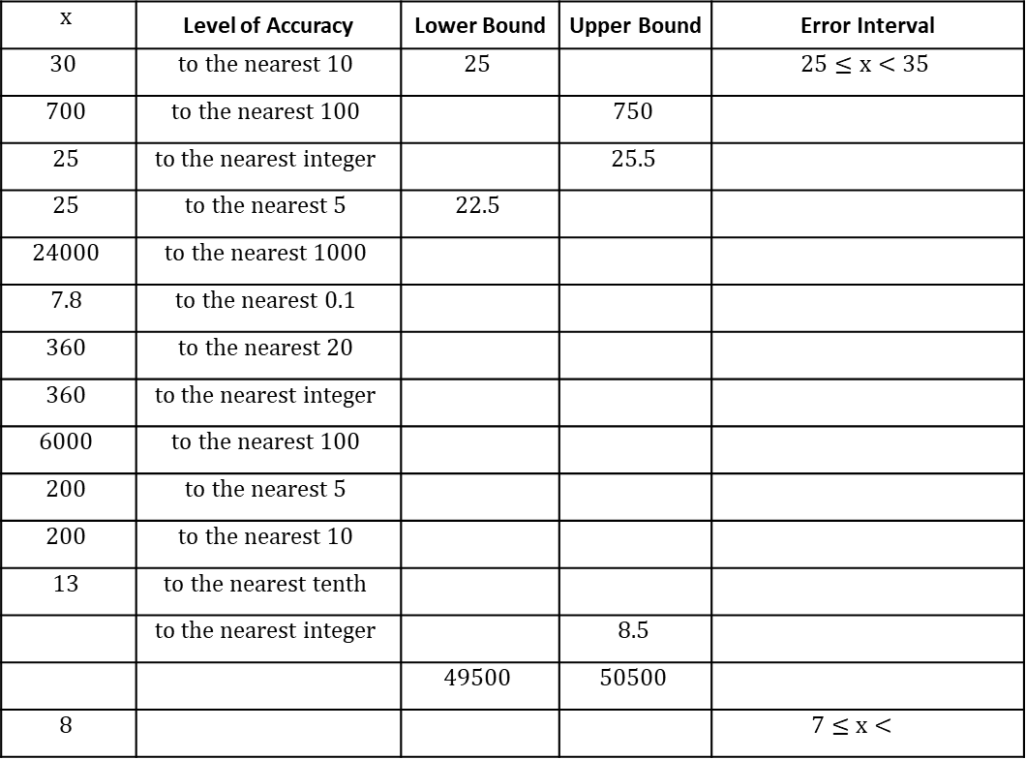
Error intervals
Example 7 - I do…
Example 8 - We do…
Example 9 – You do…
Steps | Work out the error interval for…
1. Identify the degree of accuracy stated. | What is the error interval of 62 kg, measured to the nearest kg? Lower bound = Upper bound = Error interval | What is the error interval of 285 g, measured to the nearest 5? | What is the error interval of 800 cm, rounded to the nearest 100?
2. For the lower bound, work out the lowest it could be.
3. For the upper bound, work out the greatest it can be.
4. Write these as an error interval.
Independent Practice
5. Fill in the blanks
$$x$$ | Level of Accuracy | Lower Bound | Upper Bound | Error Interval
$$30$$ | $$to the nearest 10$$ | $$25$$ |  | $$25≤x<35$$
$$700$$ | $$to the nearest 100$$ |  | $$750$$
$$25$$ | $$to the nearest integer$$ |  | $$25.5$$
$$25$$ | $$to the nearest 5$$ | $$22.5$$
$$24000$$ | $$to the nearest 1000$$
$$7.8$$ | $$to the nearest 0.1$$
$$360$$ | $$to the nearest 20$$
$$360$$ | $$to the nearest integer$$
$$6000$$ | $$to the nearest 100$$
$$200$$ | $$to the nearest 5$$
$$200$$ | $$to the nearest 10$$
$$13$$ | $$to the nearest tenth$$
 | $$to the nearest integer$$ |  | $$8.5$$
 |  | $$49500$$ | $$50500$$
$$8$$ |  |  |  | $$7≤x<$$

Slide 8
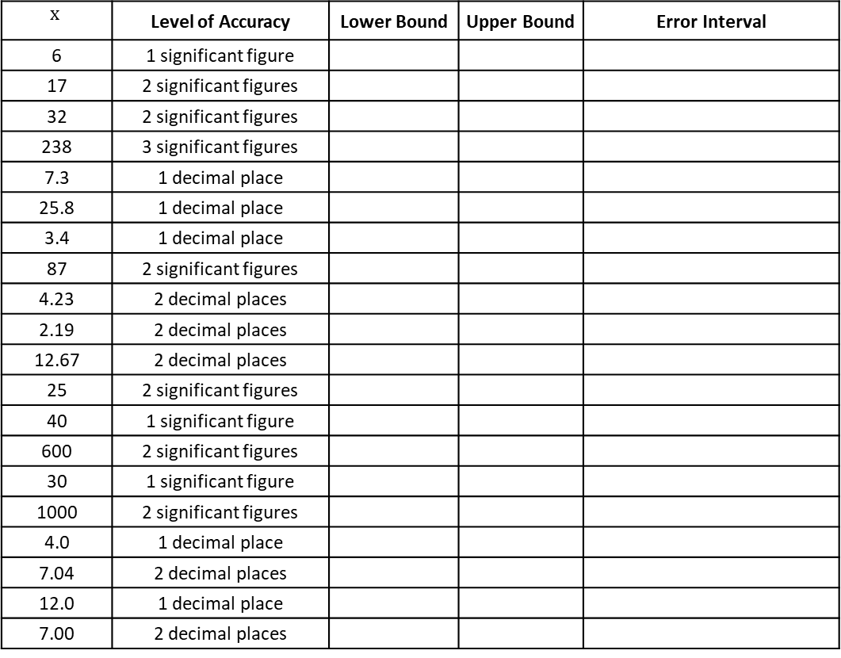
Example 10 - I do…
Example 11 - We do…
Example 12 – You do…
Steps | Work out the upper bound and lower bound for…
1. Identify the degree of accuracy stated. | What is the error interval of 620 kg, measured to two significant figures? Lower bound = Upper bound = Error interval | What is the error interval of 2.8 g, measured to one decimal place? | What is the error interval of 82cm, rounded to two significant figures.
2. For the lower bound, work out the lowest it could be.
3. For the upper bound, work out the greatest it can be.
4. Write these as an error interval.
Independent Practice
6. Fill in the blanks
$$x$$ | Level of Accuracy | Lower Bound | Upper Bound | Error Interval
6 | 1 significant figure
17 | 2 significant figures
32 | 2 significant figures
238 | 3 significant figures
7.3 | 1 decimal place
25.8 | 1 decimal place
3.4 | 1 decimal place
87 | 2 significant figures
4.23 | 2 decimal places
2.19 | 2 decimal places
12.67 | 2 decimal places
25 | 2 significant figures
40 | 1 significant figure
600 | 2 significant figures
30 | 1 significant figure
1000 | 2 significant figures
4.0 | 1 decimal place
7.04 | 2 decimal places
12.0 | 1 decimal place
7.00 | 2 decimal places

Slide 9
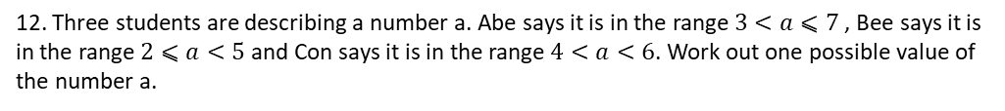
7. A bus has 53 seats, of which 37 are occupied.
The driver estimates that at the next bus stop 20 people, to the nearest 10, will get on and no one will get off. If she is correct, is it possible they will all get a seat?
8. A chain is 30 m long, measured to the nearest metre.
It is needed to fasten a boat to a harbour wall, a distance that is also 30 m, to the nearest metre.
Which statement is definitely true? Explain your decision.
A: The chain will be long enough.
B: The chain will not be long enough.
C: It is impossible to tell whether or not the chain is long enough.
9. A bag contains 2.5 kg of soil, to the nearest 100 g.
What is the least amount of soil in the bag?
Give your answer in kilograms and grams.
10. Billy has 40 identical marbles. Each marble has a mass of 65 g (to the nearest gram).
a. What is the greatest possible mass of one marble?
b. What is the least possible mass of one marble?
c. What is the greatest possible mass of all the marbles?
d. What is the least possible mass of all the marbles?
11. A whole number, when rounded to 2 significant figures, is 350. When rounded to 1 significant figure it is 300. What is the range of values for the number?
12. Three students are describing a number a. Abe says it is in the range $3<a⩽7$ , Bee says it is in the range $2⩽a<5$and Con says it is in the range $4<a<6$. Work out one possible value of the number a.

Slide 10
Truncation and Error Intervals
Introduction – Read and annotate:
In maths, truncation means cutting off a number after a certain point, without rounding. It’s like
stopping a number in its tracks! For example, if you have 3.14159 and truncate it to two decimal
places, it becomes 3.14 — no rounding up or down, just chopping off the extra digits. It’s a simple way
to simplify numbers when you don’t need them to be super precise.
Truncating numbers
Example 1 - I do…
Example 2 – We do…
Example 3 – You do…
Steps | Truncate to 4 decimal places | Truncate to 2 decimal places | Truncate to 1 decimal place
1) Identify the required digits. This is the cut off. 2) Rewrite the number without the digits after the cut off. | 43.56346 | 72.68439 | 43.56346
Example 4 - I do…
Example 5 – We do…
Example 6 – You do…
Steps | Truncate to the whole number | Truncate to the whole number | Truncate to the whole number
1) Identify the required digits. This is the cut off. 2) Rewrite the number without the digits after the cut off. | 43.56346 | 726.8439 | 4.356346
Independent Practice
1. Complete the table:
Number | Truncate to 1 decimal place | Truncate to 2 decimal places | Truncate to the whole number
89231.625
0.05681
0.0002563
23.145
19.99999

Slide 11
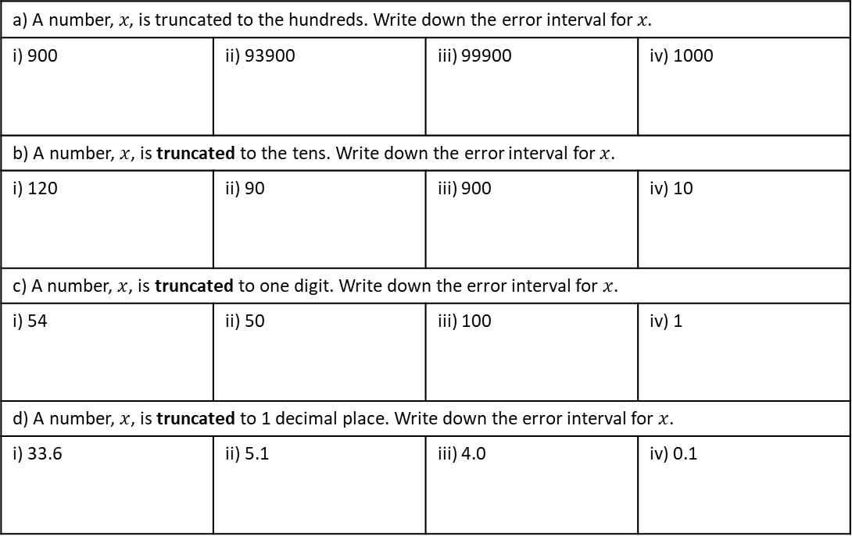
Example 4 - I do…
Example 5 – We do…
Example 6 – You do…
Steps | A number, y, is truncated to an integer. Write down the error interval for y if the result is 14. | A number, y, is truncated to 2 decimal places. Write down the error interval for y if the result is 93.20. | A number, y, is truncated to an integer. Write down the error interval for y if the result is 50.
1) The result is the lower bound. 2) One increment above this is the upper bound.
Independent Practice
11. Answer the following questions:
a) A number, 𝑥, is truncated to the hundreds. Write down the error interval for 𝑥.
i) 900 | ii) 93900 | iii) 99900 | iv) 1000
b) A number, $x$, is truncated to the tens. Write down the error interval for $x$.
i) 120 | ii) 90 | iii) 900 | iv) 10
c) A number, $x$, is truncated to one digit. Write down the error interval for $x$.
i) 54 | ii) 50 | iii) 100 | iv) 1
d) A number, $x$, is truncated to 1 decimal place. Write down the error interval for $x$.
i) 33.6 | ii) 5.1 | iii) 4.0 | iv) 0.1
Mixed Practice
a) A number, n is truncated to 1 decimal place. The result is 18.1. Write down the error interval for n. | b) Oscar rounds a number, y, to the nearest integer. His result is 100. Write down the error interval for y. | c) The mass of a coin is 8 grams to the nearest gram. Write the error interval for the mass of the coin.

Slide 12
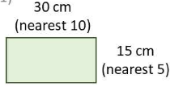
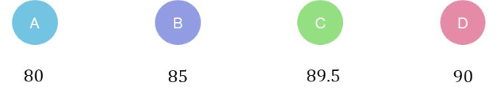
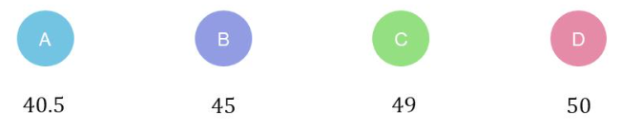







g) The people living in two villages are counted 300 and 800 to the nearest 100. Write down the error interval to show the total maximum and minimum number of villagers. | h) To the nearest gram, a doughnut has 7 grams of sugar, and a bun has 2 grams of sugar. Write down the error interval for the total sugars. | i) Grace takes 9 minutes to the nearest minute to complete a crossword. George takes 11 minutes to the nearest minute. Show that the total time to complete could be 20 minutes 50 seconds.
k) The length of each side of a regular hexagon is 4.7cm to 1 decimal place. Write the error interval for the perimeter, P. | l) Write down the error interval for the perimeter of this rectangle. | m) To the nearest 10cm, John is 150cm tall and Sally is 120cm tall. What is the greatest height difference between them?
Skills Check
A number, n, has been truncated to the tens and the answer is 90. What is the lower bound for n?
A number, n, has been truncated to the tens and the answer is 40. What is the upper bound for n?
A tin of sweets says ‘this tin contains 800 sweets, to the nearest 10’. What is the greatest number of sweets that could be in the tin?
A room is measured as 4.7 metres to 1 decimal place. What is the smallest possible length of the room?
Which of the following is the correct error interval for 78cm rounded to the nearest cm?
A number, n, has been truncated to 1 significant figure and the answer is 0.06. Which of the following represents the error interval for n?
810
805
804
849
4m
4.7m
4.6m
4.65m
77.5 < x $≤$ 78.5
77.5 < x < 78.5
77.5 $≤$ x < 78.5
77.5 $≤$ x < 78.4
0$.0 ≤$ n < 0.1
0.055 $≤$ n < 0.065
0.06 $≤$ n < 0.07
0.06 $≤$ x < 0.069

Slide 13
Problems involving limits of accuracy
LEARNING OUTCOME: To solve problems with upper and lower bounds.
Objectives:
Keywords:
-Error interval
-Limits of accuracy
-Lower bound
-Upper bound
To find the limits of accuracy.
To find the limit of accuracy of two or more variables.
3. To answer worded questions on limit of accuracy.
Definition
Characteristics
Upper Bound: The maximum value a number or measurement can be.
Lower Bound: The minimum value a number or measurement can be.
Values that define the upper and lower limits of a number or function, especially in rounding or error intervals.
Bounds
Examples
Non - Examples
When 15 is rounded to the nearest integer, the lower bound is 14.5 and the upper bound is 15.5
When 15 is rounded to the nearest integer, the lower bound is 14 and the upper bound is 15.4
Adding with bounds
Example 1 - I do…
Example 2 - We do…
Example 3 – You do…
Steps
When we add with bounds, we need to find the upper bound and the lower bound. | A rectangle has the width of 70mm and the length of 100mm both correct to the nearest 10mm. Find the upper and lower bounds for perimeter. Upper bound = Lower bound = | A rectangle has the width of 13cm and the length of 24cm both correct to the nearest cm. Find the upper and lower bounds for perimeter. Upper bound = Lower bound = | A rectangle has the width of 7m and the length of 10m both correct to the nearest metre. Find the upper and lower bounds for perimeter. Upper bound = Lower bound =
The upper bound of a addition is always the two upper bounds added together.
The lower bound of addition is always the two lower bounds added together
Independent Practice
1. Fill in the blanks

Slide 14
Independent Practice
1. Steve measures the length and width of a rectangle as 600mm and 400mm, both correct to 10mm.
Find the upper and lower bounds for the perimeter of the rectangle.
Upper bound = Lower bound =
2. Ola’s weight is 47kg, correct to the nearest kg. Tia’s weight is 55kg, also correct to the nearest kg. Find the upper and the lower bounds of the total weight of the two girls.
Upper bound = Lower bound =
3. The length of each side of a regular hexagon is 4.7cm to 1 decimal place.
Work out the upper and lower bound of the perimeter.
Upper bound = Lower bound =
4. Grace and George complete a crossword. It takes Grace 9 minutes to complete the crossword to the nearest minute. It takes George 11 minutes to complete the crossword to the nearest minute.
Work out the upper and lower bound of the total time taken to complete the crossword.
Upper bound = Lower bound =

Slide 15
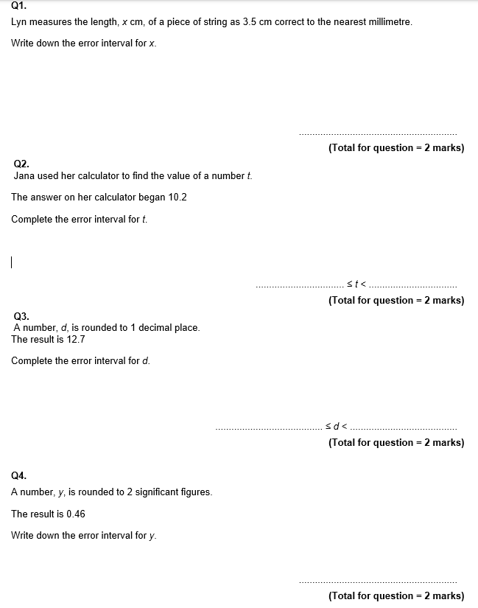
GCSE Past Paper Questions

Slide 16
